Slide 1
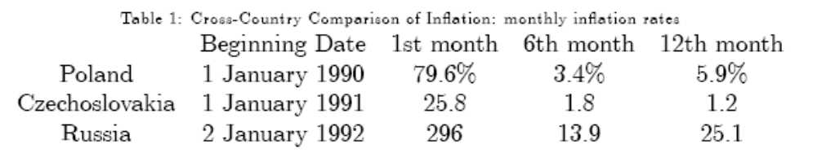
Price Liberalization
Necessary to relieve repressed inflation
  Monetary overhang
Necessary because of arbitrary pricing
  Prices must be deregulated to let the market work
Price liberalization led to price explosion
Why?

Slide 2
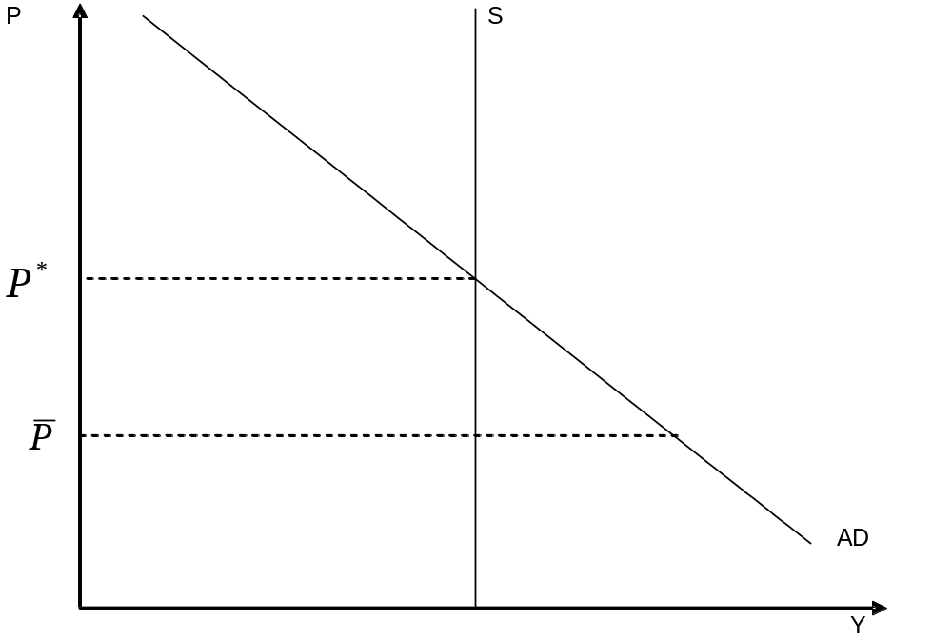
Repressed Inflation
Repressed inflation means price level is below market-clearing => shortages, queuing, black markets

Slide 3
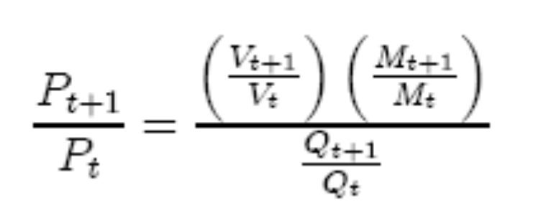
Price Explosion
Start with equation of exchange, MV = PQ, so
Then the price change is
Output is not changing much immediately, but, if anything, falling
Money stock not changing much
So it must be velocity causing the explosion
  Fear of inflation causes velocity to rise

Slide 4
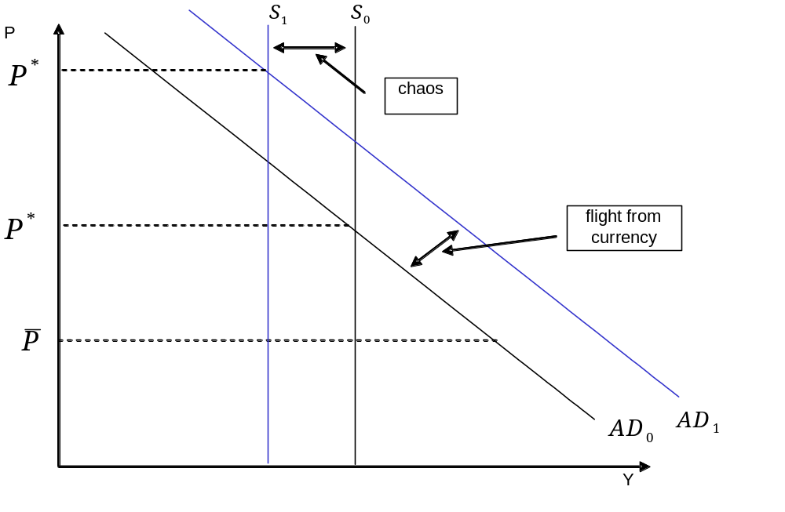
Price Explosion

Slide 5








Flight from Currency
Flight from currency
Velocity increases
Monetary Overhang

Slide 6


Anatomy of Price Explosion
chaos
Flight from currency
Velocity increases
Monetary Overhang

Slide 7
Why does velocity explode?
Lack of inflation proof assets under socialism
  Spend or lose
  500 days plan would have created assets
External liberalization
Fear of further inflation
  Expectations of further inflation
Monetary anchor
  Requires fixing exchange rate
    Poland fixed zloty to dollar for 14 months
  Requires external liberalization

Slide 8
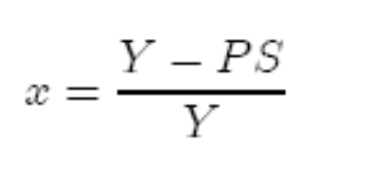
Welfare Implications
Prices can rise, real output can fall and welfare still increase
  How?
  Queues fall
  Liberalization removes excess demand
Simple model
  Output fixed at S
  National Income (nominal) exogenous, Y
  No savings, then excess demand is

Slide 9


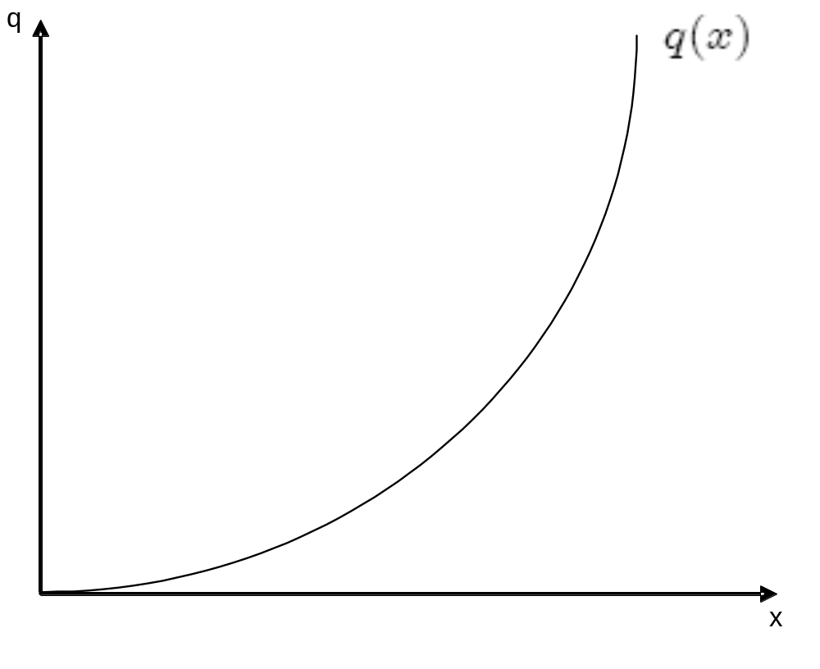
Endogenous Queues
implies queues
Let queues depend on x, so and an increasing function

Slide 10
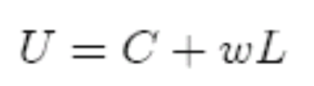
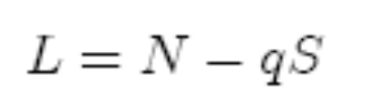

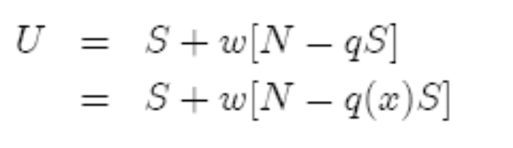
Utility
Utility depends on consumption and leisure
Leisure depends on total (nonworking) hours and queueing:
So
But consumption = supply of goods, so

Slide 11

Welfare and excess demand
Excess demand raises q => U falls
  Implies that when x > 0 measured real income is inversely related to welfare
As long as there is no excess demand
  Utility rises with income
If utility is a decreasing function of real income
So real income can fall and welfare rise when prices are liberalized
Supply effects augment this gain

Slide 12
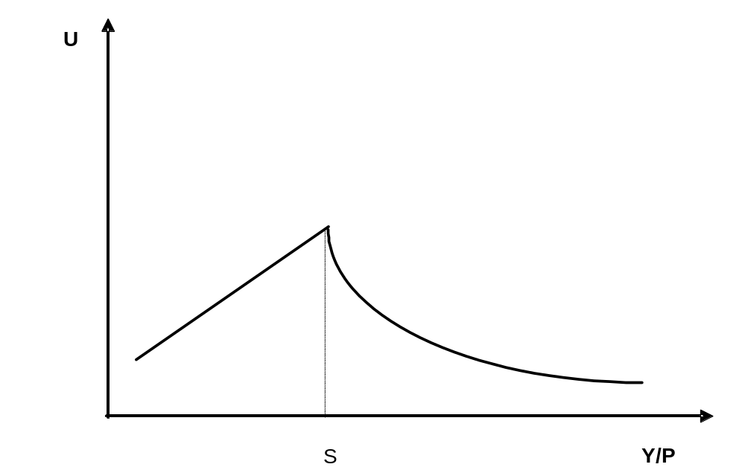
Real Income and Welfare

Slide 13
Welfare Gains Disaggregated
Overall gains – aggregate gains
  But there are distributional consequences
Women gain relative to men
  Women disproportionately queue
  q falls, but C does not rise
  Bargaining power in the household
Elderly lose relative to working people
  Opportunity cost of time increases

Slide 14
Liberalization and Inflation
Four Reason why inflation explodes
  Removal of price controls
    But why don’t some prices fall
  Monetary financing of deficits
  Credit expansion to support enterprises
    Soft budget constraints
  Monetary overhang
    Spending of forced savings
Key point: inflation is costly
  But it does make relative price adjustment easier

Slide 15
Costs of Inflation
“Unemployment, the precarious life of the worker, the disappointment of expectation, the sudden loss of savings, the excessive windfalls to individuals, the speculator, the profiteer--all proceed, in large measure, from the instability of the standard of value
It is often supposed that the costs of production are threefold... labor, enterprise, and accumulation. But there is a fourth cost, namely, risk; and the reward of risk-bearing is one of the heaviest, and perhaps the most avoidable, burden on production....[T]he adoption by this country and the world at large of sound monetary principles, would diminish the wastes of Risk, which consume at present too much of our estate.
  John Maynard Keynes, Tract on Monetary Reform

Slide 16
Controlling Inflation
Disinflation was less costly in transition economies. Why?
  Less time to adjust to high inflation
  External liberalization provides some anchor
  Other reforms help → hardening budget constraints
    Expectations of enterprises
    Consumers always have hard-budget constraints
    Wholesale inflation > CPI inflation
High inflation was tamed across the board

Slide 17
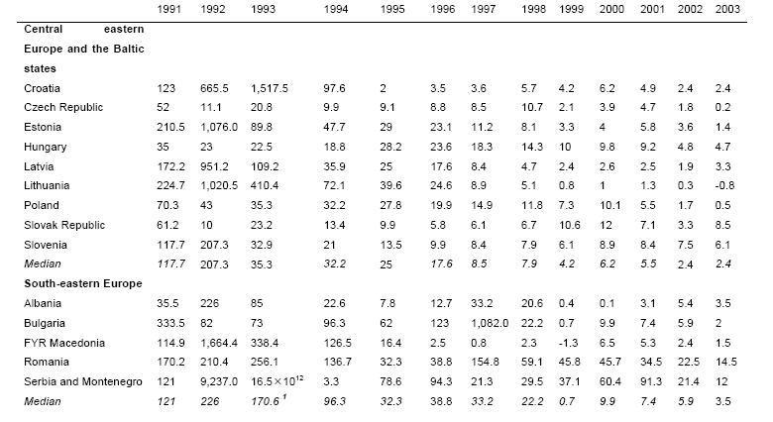
Disinflation in CE and Baltics

Slide 18
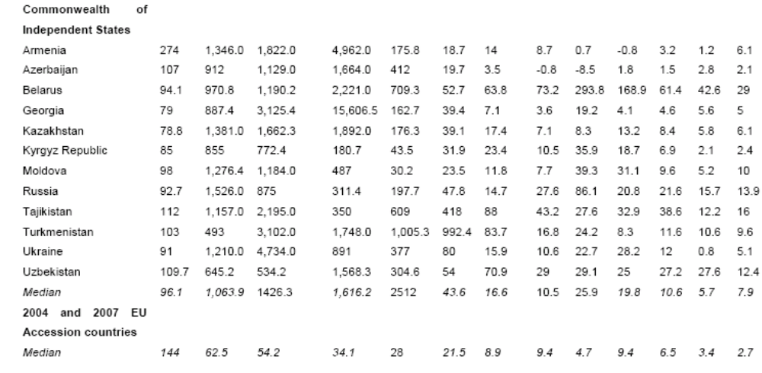
Disinflation in FSU

Slide 19
External Liberalization
Elimination of FTM
  STE trade: export to import key goods
  STE taxed agriculture and emphasized industry
    But low quality due to SBC’s
End of CMEA trade
  Trade diversion versus trade creation
  Taking in the wash
  Hard versus soft goods
CMEA countries traded the wrong goods with the wrong countries
Negative value added, NVA
  Market value of output less than the market value of the purchased inputs utilized => primary factors – labor and capital – completely wasted
  Pervasive feature of transition

Slide 20




Negative Value Added
Industrial structure destroys value at world prices
  Two inputs, one primary, and materials, m
Gross output in sector i given by
Value added at domestic prices:
Assume though this not need be the case
Domestic prices differ from world prices

Slide 21


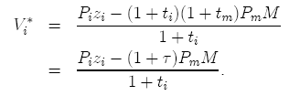
More NVA
The relative price is thus:
  We call the coefficient of protection
Now VA at world prices is:
So

Slide 22
NVA
Thus if is large enough we can have V_{i}* < 0, even if V_{i} > 0.
  This is likely if materials are under-priced as in STE’s
  This is likely because FTM separates domestic and world prices
  But external liberalization will mean that sector i will not be viable
    Notice that shutting down sector i actually raises national income

Slide 23
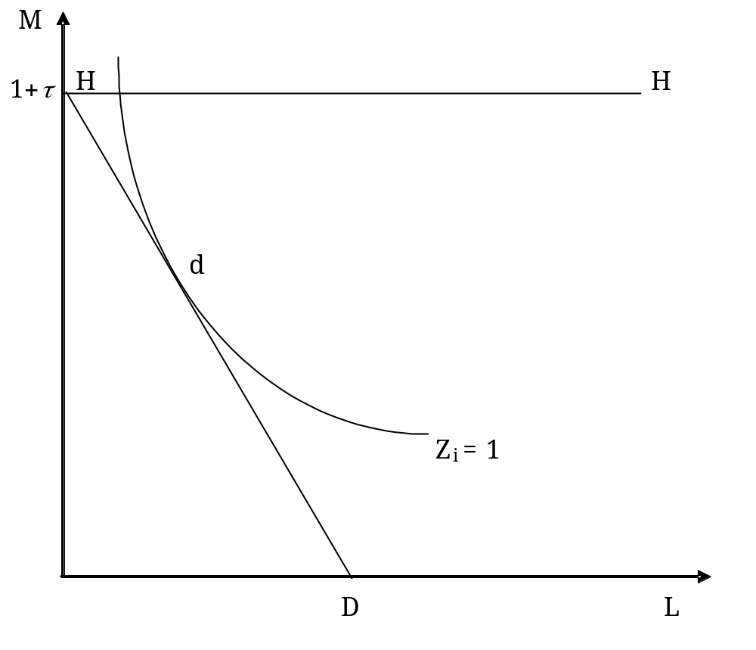
Graphical Representation: Production at Protected Prices

Slide 24
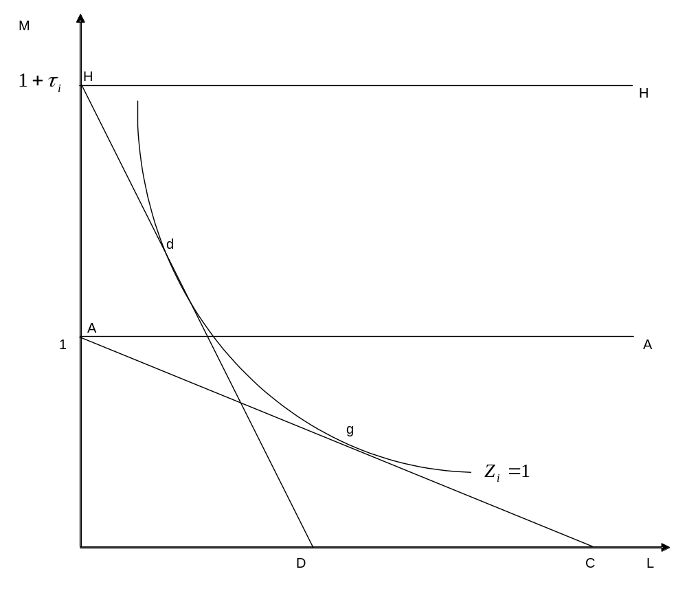
Graphical Representation

Slide 25
NVA
At domestic prices production is at d
  V > 0 at domestic prices, but V* < 0
At world prices efficient production is at g
  How to go from d to g?
Two adjustment methods
  Increased efficiency, isoquant shifts inwards
    How steep is the ray through point d
  Substitution of labor for materials
    Depends on what happens to the wage, and how rigid is the production process
What if production is even less efficient?

Slide 26
What to do?
Temporary protection
  Provide time to adjust
  Feasible if V > 0
    Pessimistic case is more problematic
  Incentive problems
    Rent seeking
  Openness needed for competition
Currency depreciation
  Makes inflation stabilization more difficult

Slide 27
NVA
How can we have NVA?
  Prices very wrong in STE’s, so wrong bundles chosen
  X-inefficiency
  Low quality due to soft-budget constraint
    The world price of the manufactured good is very low
  Privatization and hard budget constraints will help
    Takes time
    Temporary protection?
    Corruption and rent-seeking
      Logovaz
  Can devaluation solve this?
    Depends on what happens to wages

Slide 28
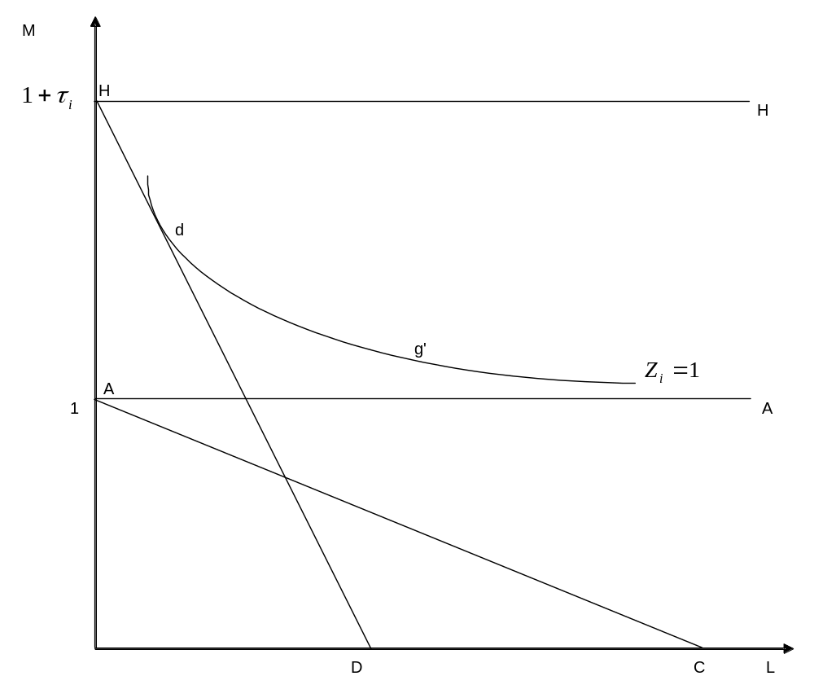
Pessimistic Case

Slide 29
Exchange Rates
Convertibility
  Goods and money convertibility
Fixed vs Flexible exchange rate
  Monetary anchor needed
  Risky with capital mobility
  Requires control over inflation
  Currency board
    Estonia
    Bulgaria

Slide 30
Currency Depreciation
Why does the currency depreciate so much?
  Under planning overvaluation
    Not consequential
  Four factors
    Monetary overhang
    Pent-up demand for foreign assets
    Inflationary expectations
      Not enough domestic assets
    Abrupt trade liberalization

Slide 31
Real Appreciation
Long run effect is real appreciation. Why?
Success means capital inflows
Inflation stabilization
Improvements in productivity
  Balassa-Samuelson effect
    Productivity rises faster in traded goods
    Labor mobility implies wages rise in both sectors
Dutch Disease

Slide 32
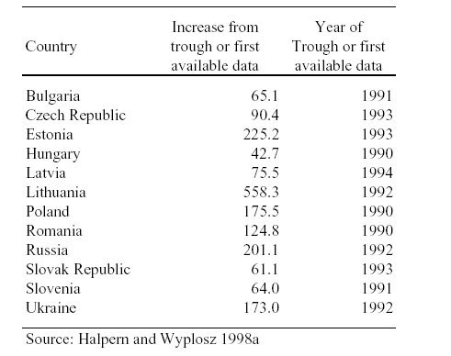
Real Appreciation

Slide 33
One more thing
Breakup of Ruble Zone
In FSU, 15 new central banks
Internal trade now international trade
Cash vs non-cash emission
Exporting inflation
  Free rider problem

